Slide 1
European Gender Equality Index
File created on: 11/1/23 8:35:54 PM EDT

Slide 2
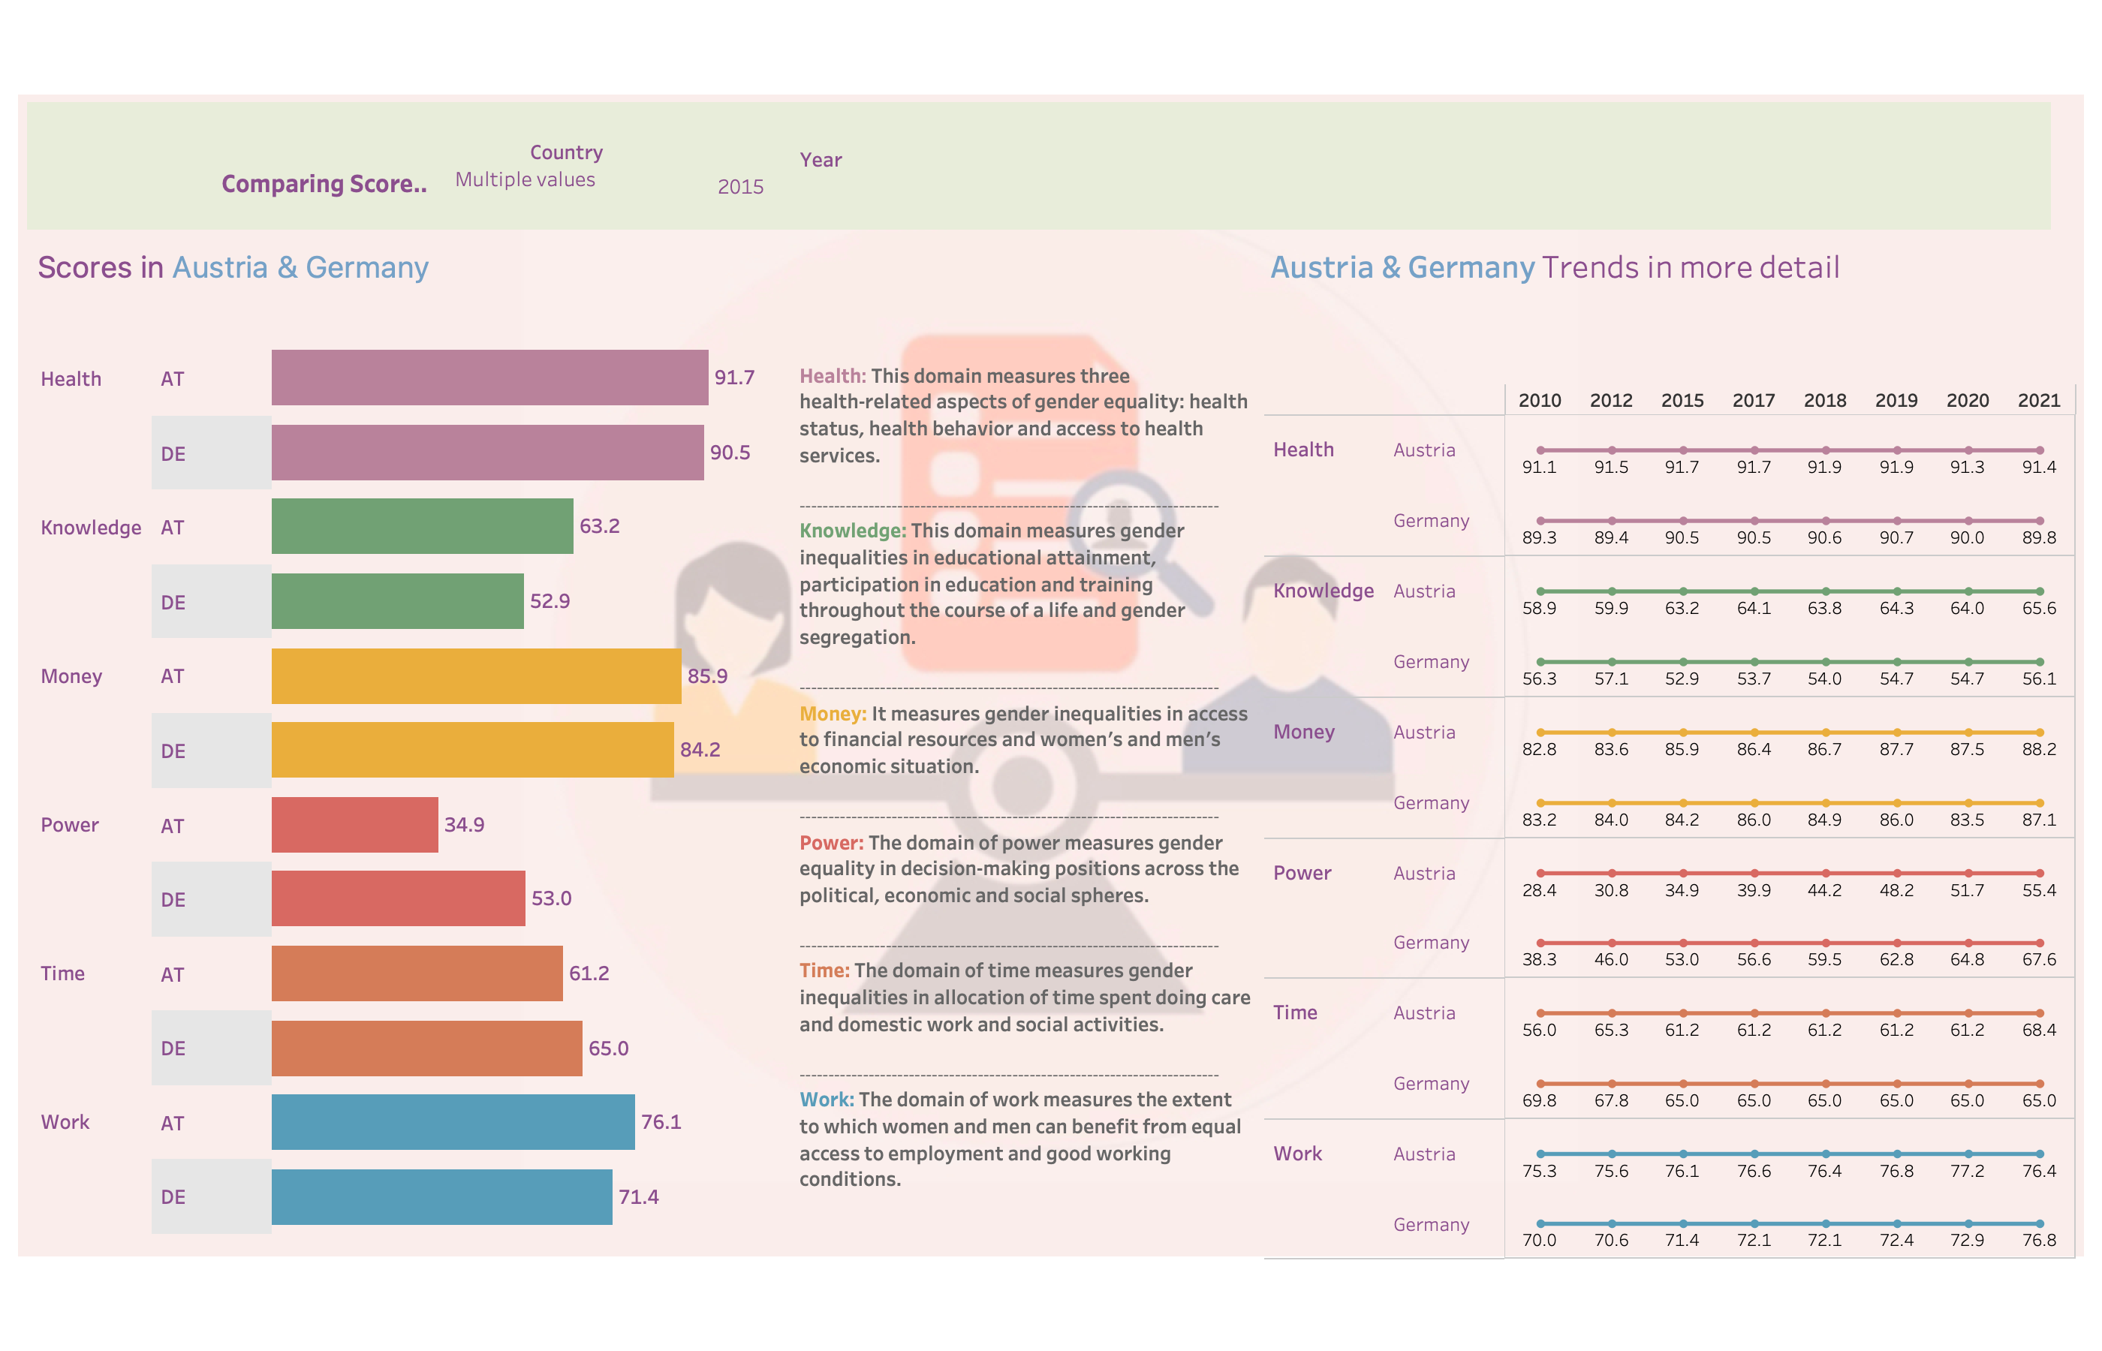

Slide 3
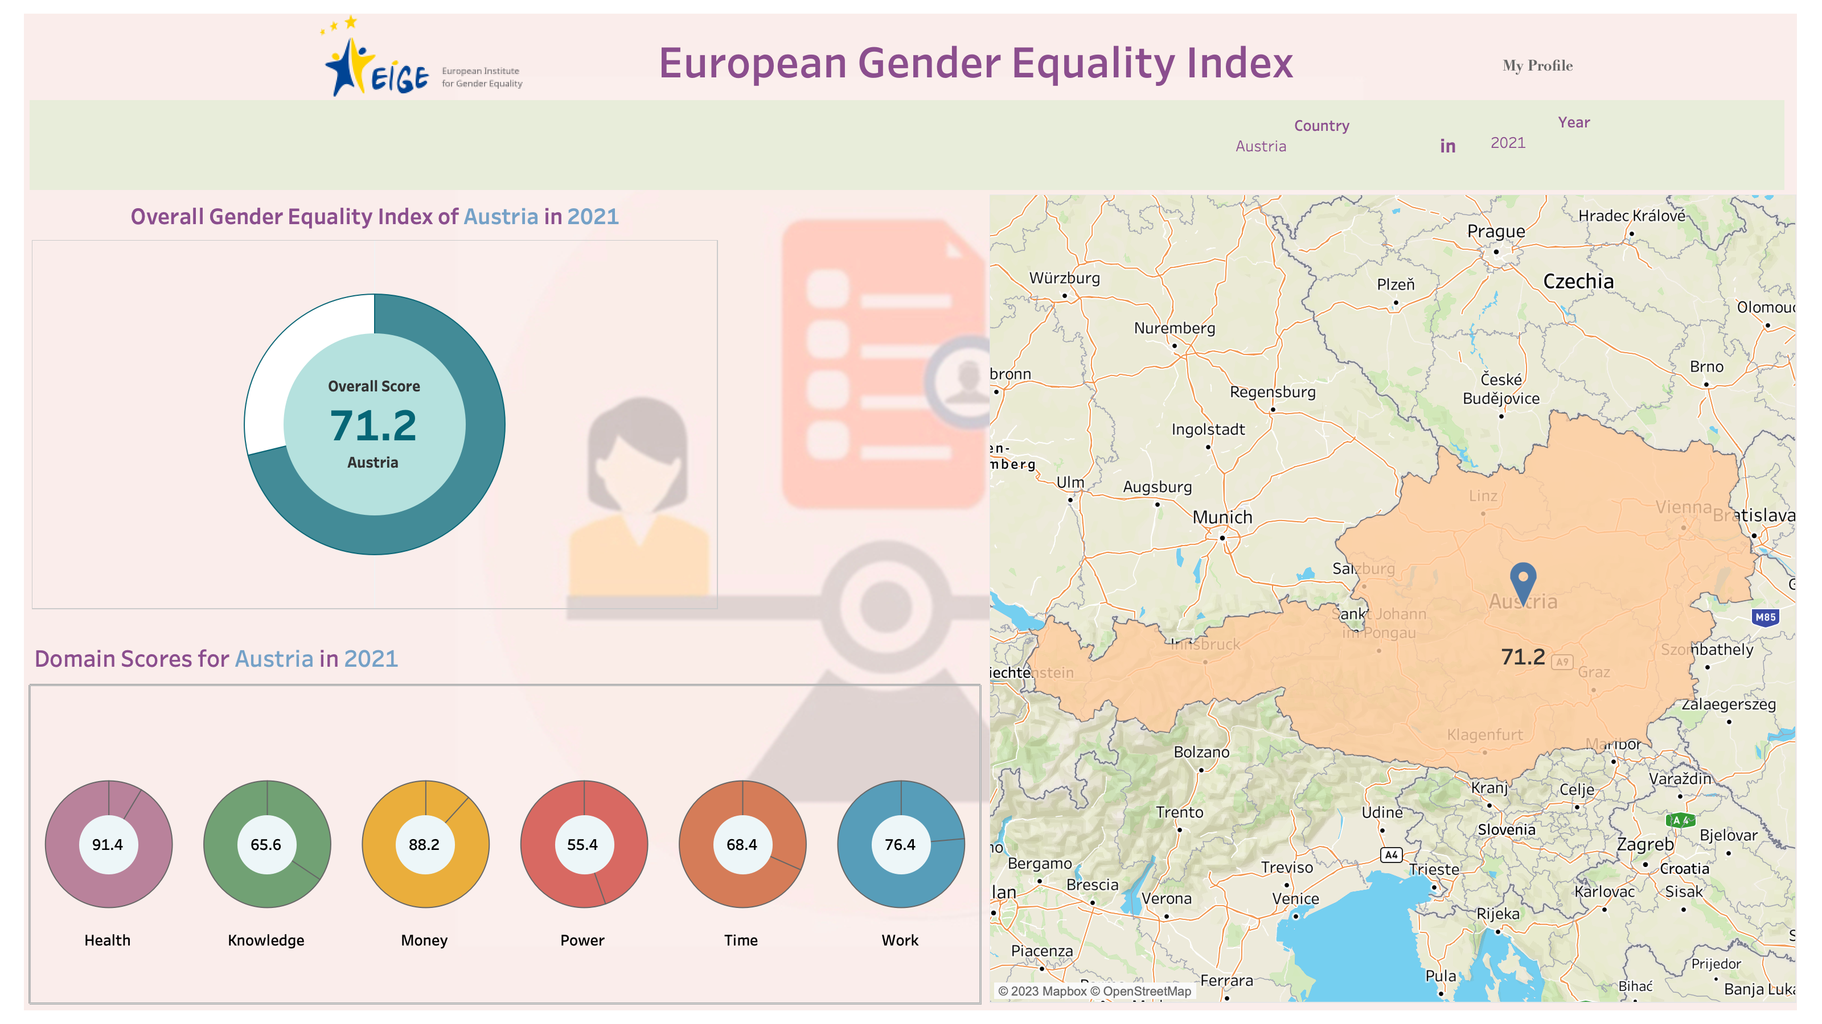

Slide 4
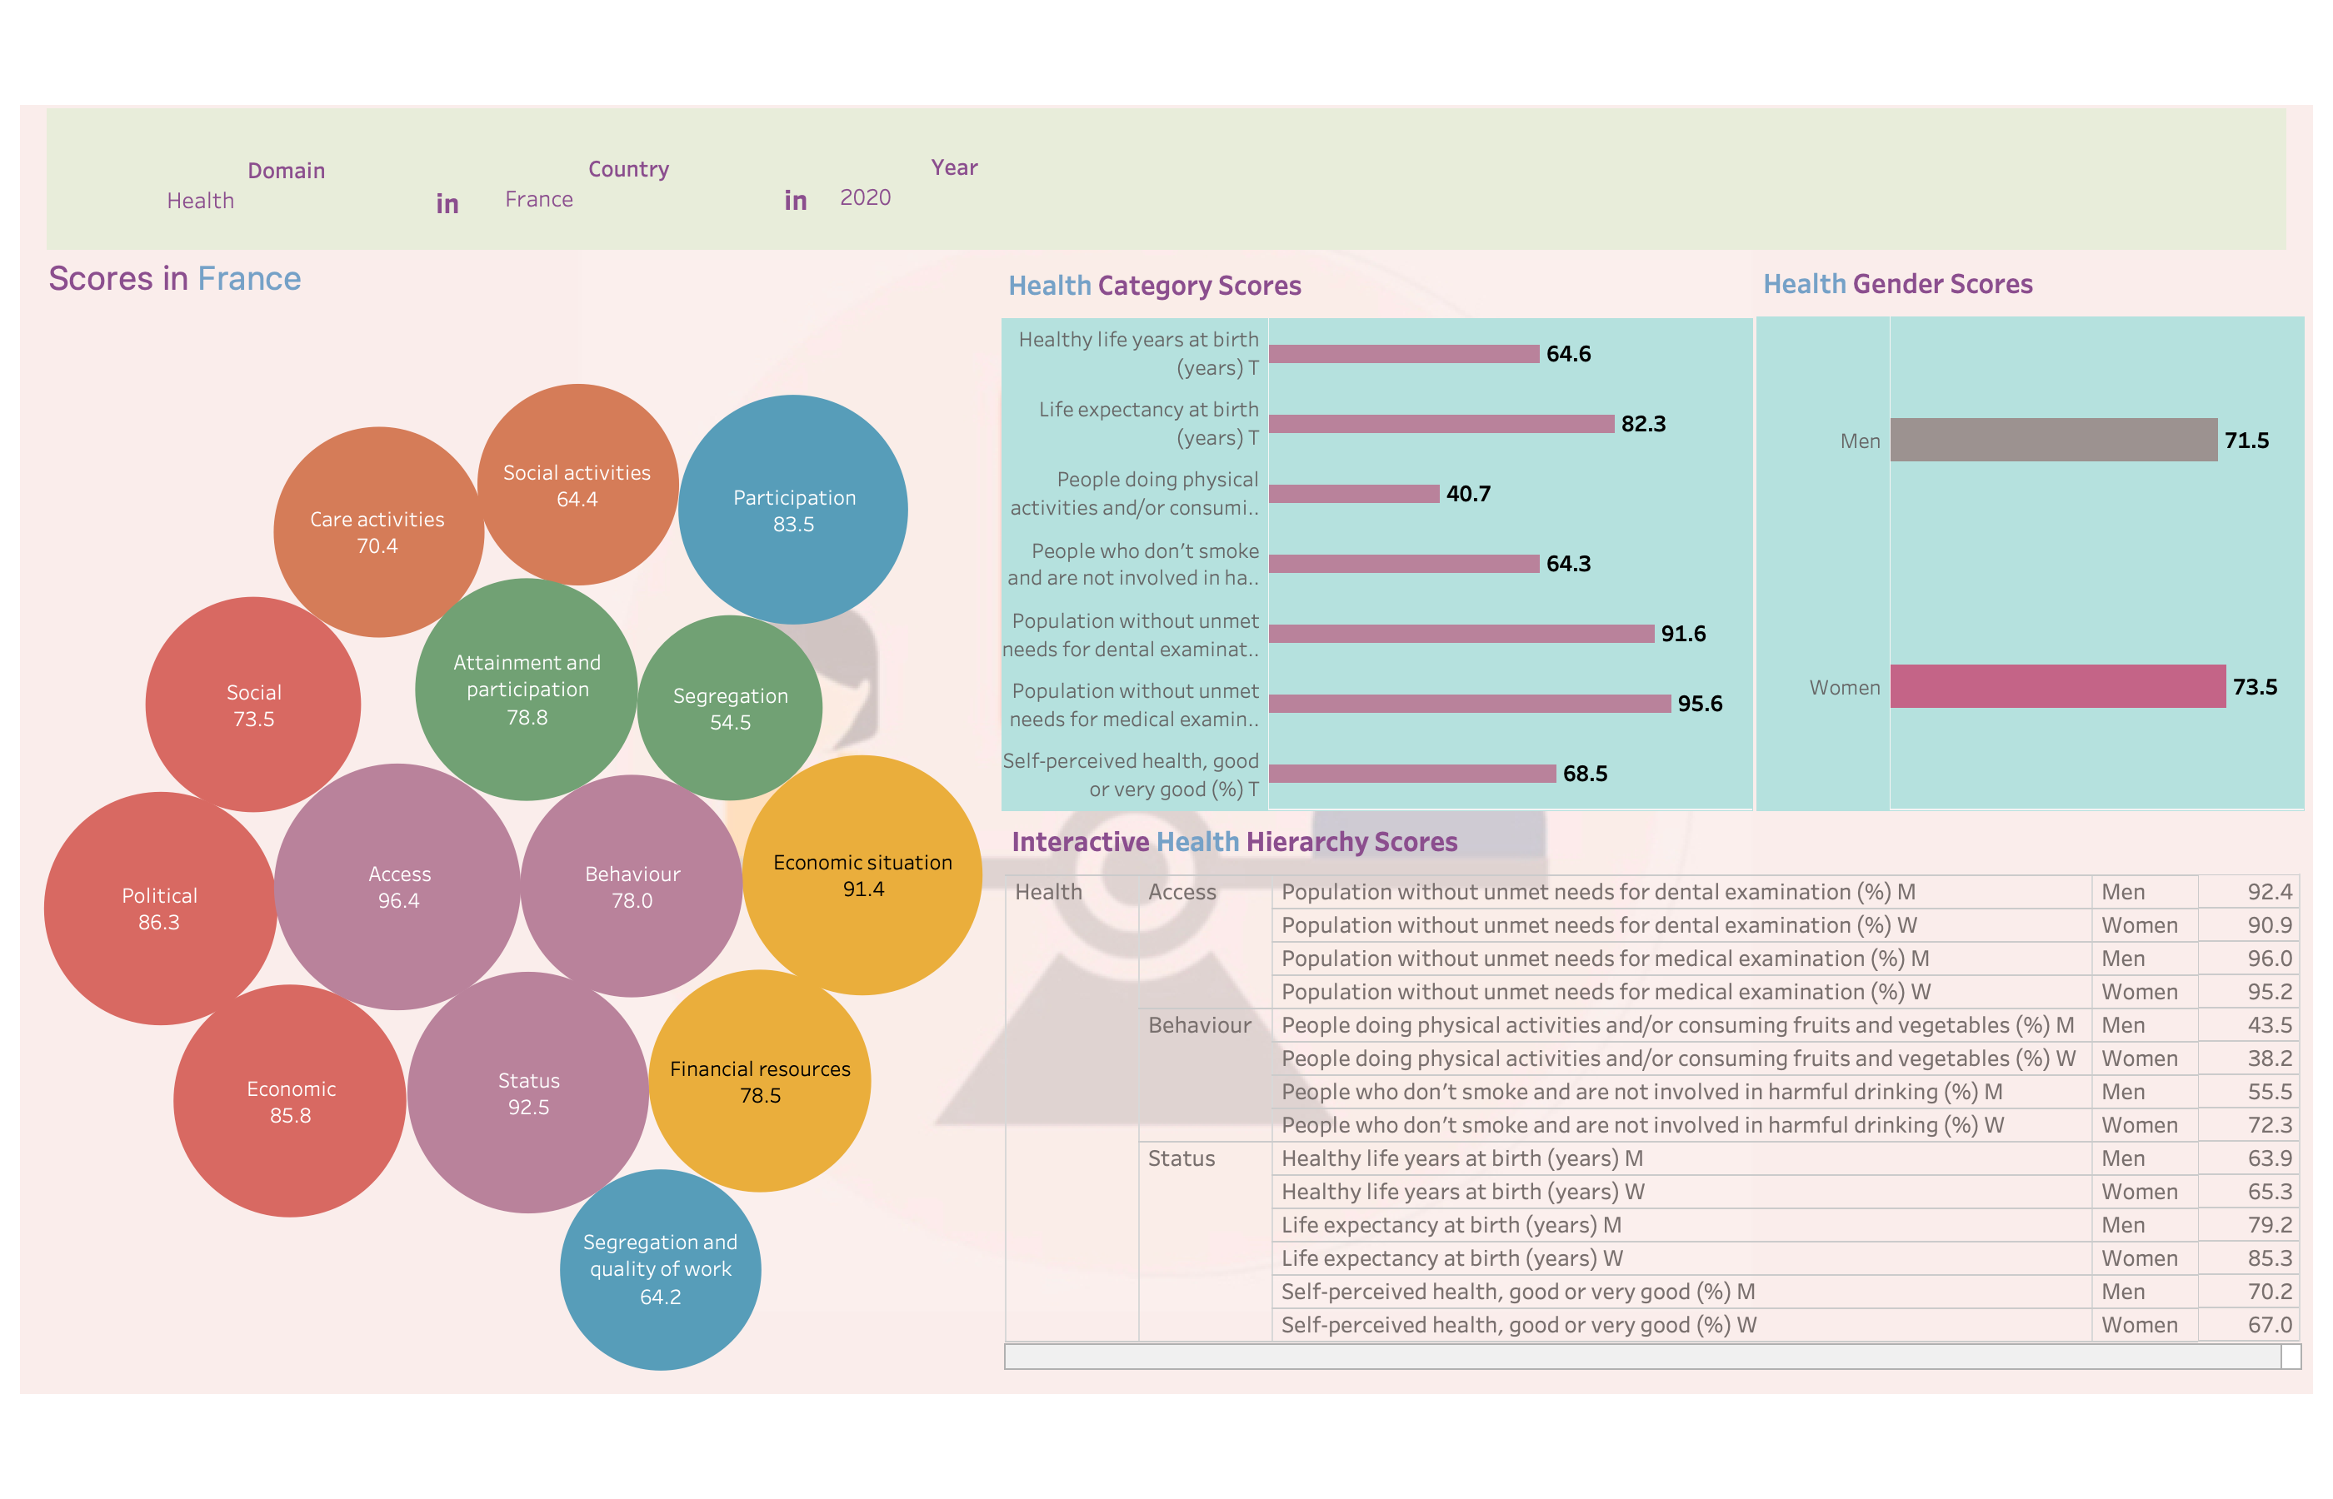

Slide 5
